Slide 1
RCCG North America
Camp Project in Nigeria

Slide 2
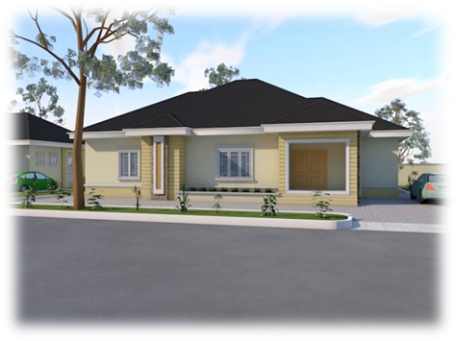
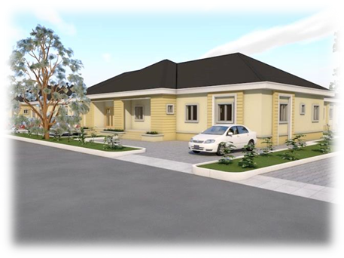
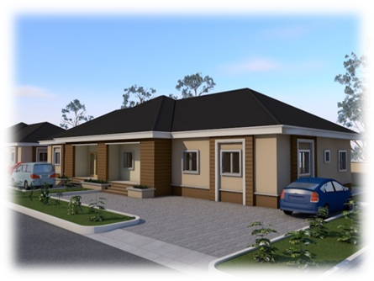
Proposed
ESTATE DEVELOPMENT
REDEMPTION CAMP, NIGERIA

Slide 3
Main Entrance

Slide 4
SITE FEATURES
Unique and beautiful landscape and scenery.
Total estate square area about 30,000 square meters.
Consists of various types including Fully Detached,
Semi-detached and Terrace bungalows
Shopping Center
Park and Recreational facilities
HOUSE TYPES
4 BEDROOM FULLY DETACHED BUNGALOW
Area 695 square meters.
3 BEDROOM SEMI DETACHED BUNGALOW
Area 333 square meters.
2 BEDROOM TERRACE BUNGALOW
CORNER PLOT
INNER PLOT
Area 310 square meters.
Area 245 square meters

Slide 5
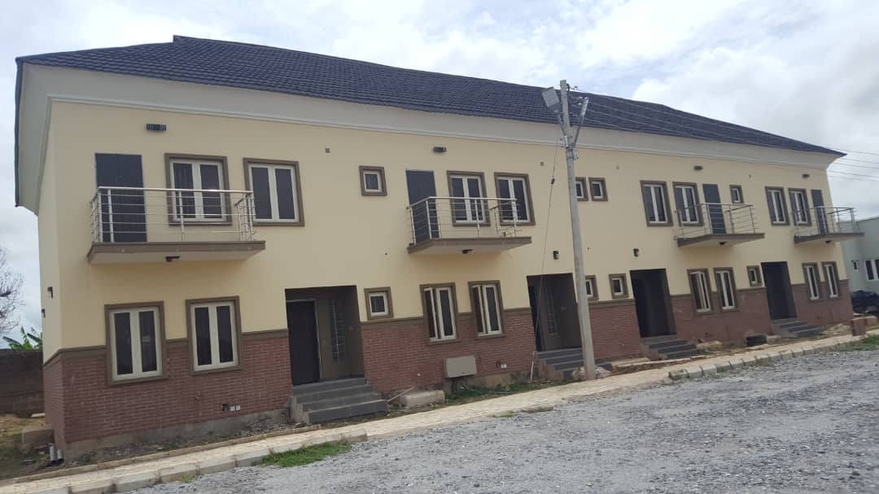
3 Bedroom Town Houses (N16m each)

Slide 6
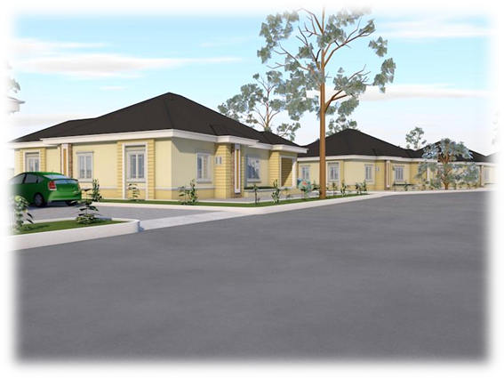
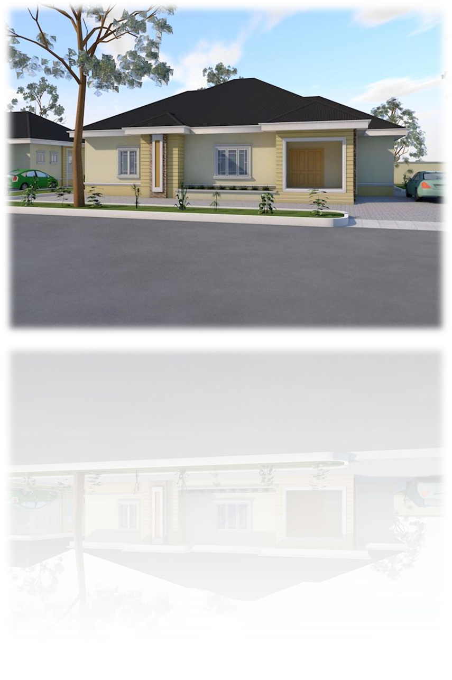
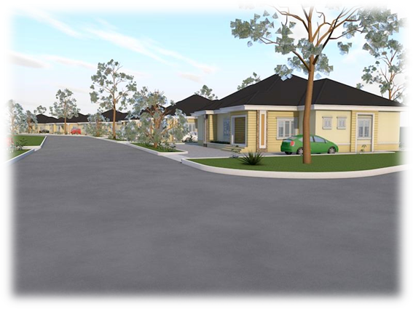
4BEDROOM FULLY DETACHED BUNGALOW (N21m each)

Slide 7
4 BEDROOM FULLY DETACHED BUNGALOW
LIVING ROOM
1
BEDROOMS
4
BATHROOMS AND TOILETS
5
PLOT AREA
668 square meters.
BUILT AREA
244 square meters.
SPECIFICATIONS.
*Aluminium roofing sheets,
*Built up wardrobes and *kitchen worktop
*Optimum quality doors
*Royal exotic tiles
*POPceiling

Slide 8
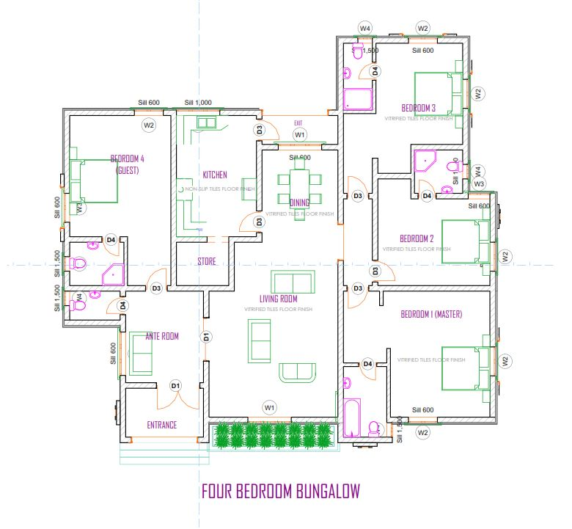
4 BEDROOM FULLY DETACHED BUNGALOW
GROUND FLOOR PLAN

Slide 9
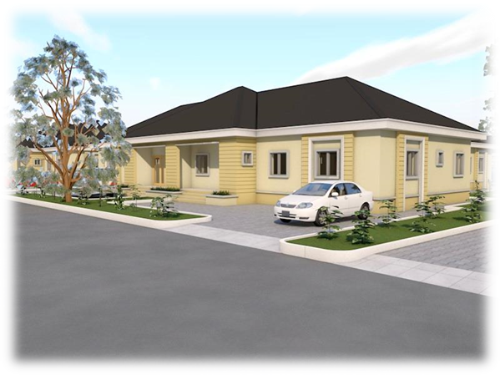
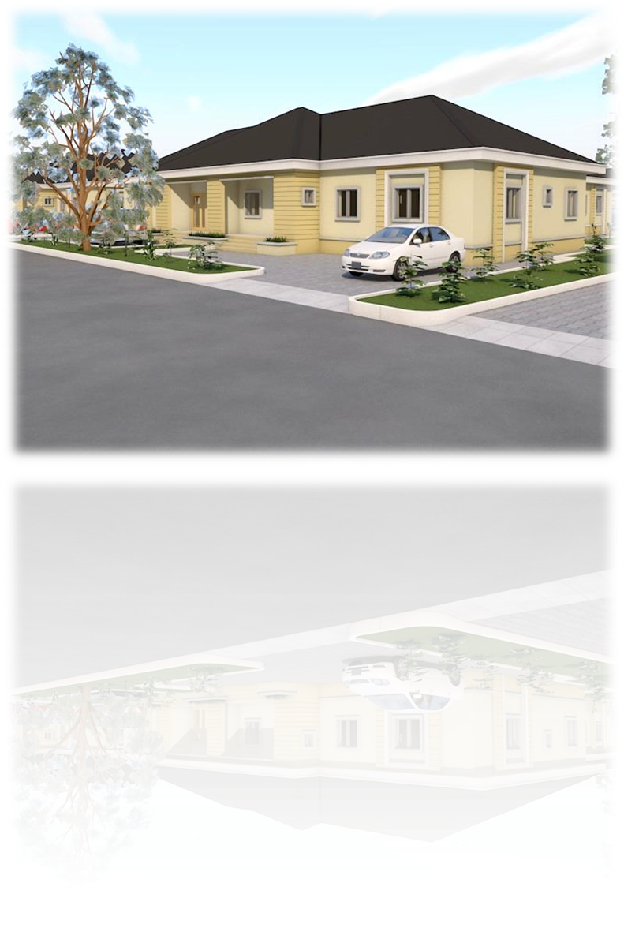
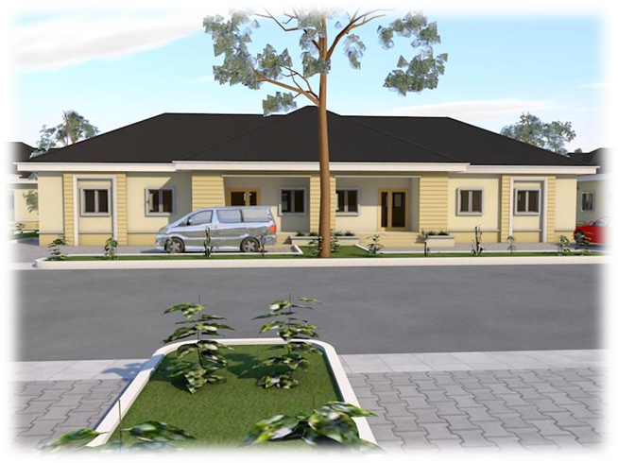
3 BEDROOM SEMI- DETACHED BUNGALOW (N14m each)

Slide 10
3 BEDROOM SEMI- DETACHED BUNGALOW
LIVING ROOM
1
BEDROOMS
3
BATHROOMS AND TOILETS
3
PLOT AREA
333 square meters.
BUILT AREA
152 square meters.
SPECIFICATIONS.
*Aluminium roofing sheets,
*Built up wardrobes and *kitchen worktop
*Optimum quality doors
*Royal exotic tiles
*POPceiling

Slide 11
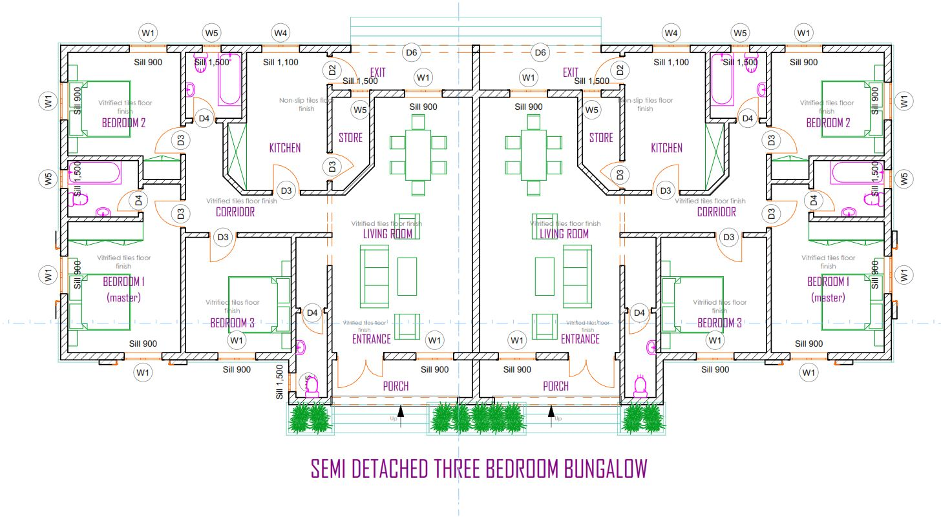
3 BEDROOM SEMI- DETACHED BUNGALOW
GROUND FLOOR PLAN

Slide 12
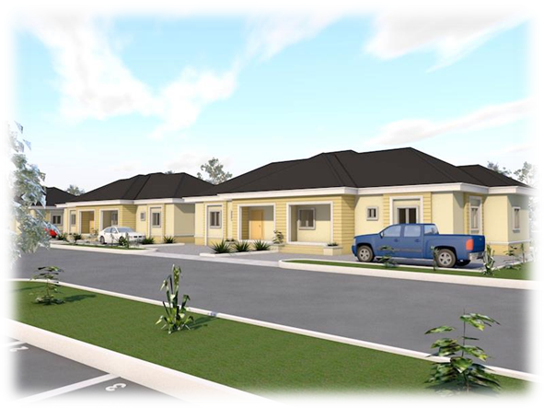
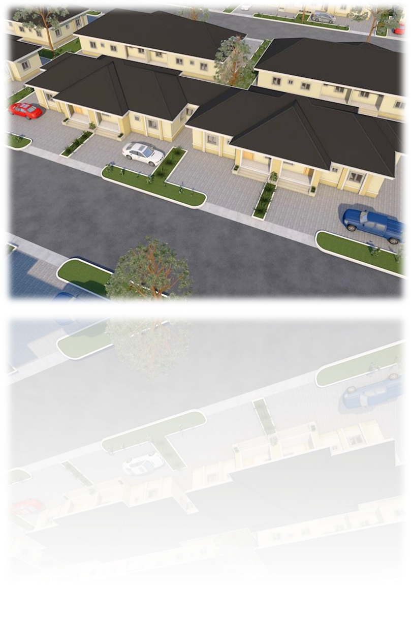
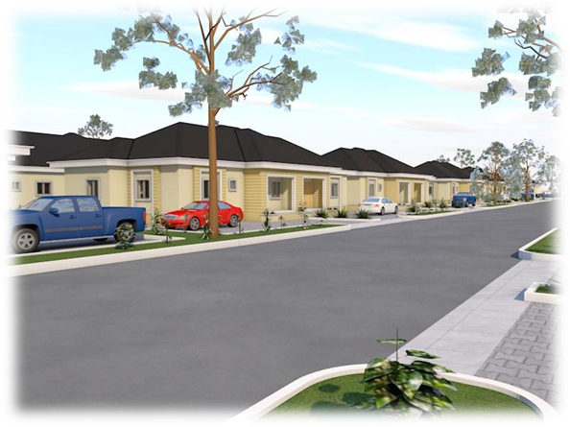
2BEDROOM semi-Detached BUNGALOW (N11.5m each)

Slide 13
2 BEDROOM SEMI DETACHED
LIVING ROOM
1
BEDROOMS
2
BATHROOMS AND TOILETS
2
310 square meters.
248 square meters
BUILT AREA
130 square meters.
SPECIFICATIONS.
*Aluminium roofing sheets,
*Built up wardrobes and *kitchen worktop
*Optimum quality doors
*Royal exotic tiles
*POP ceiling

Slide 14
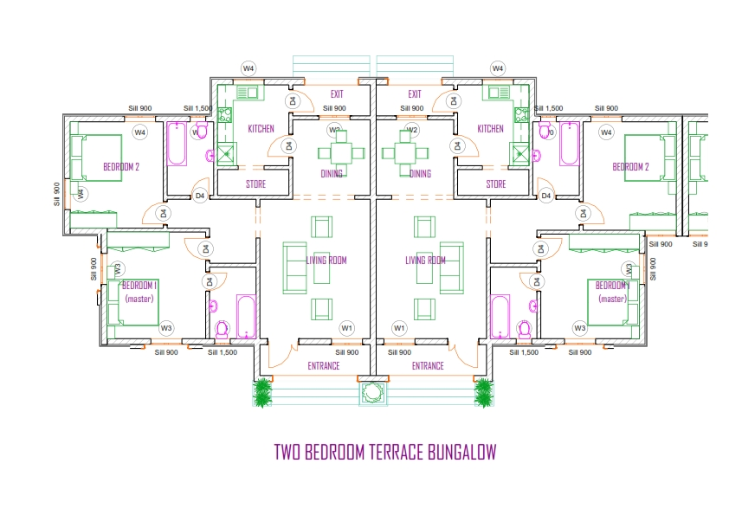
2 BEDROOM TERRACE BUNGALOW
GROUND FLOOR PLAN (ZOOM)

Slide 15
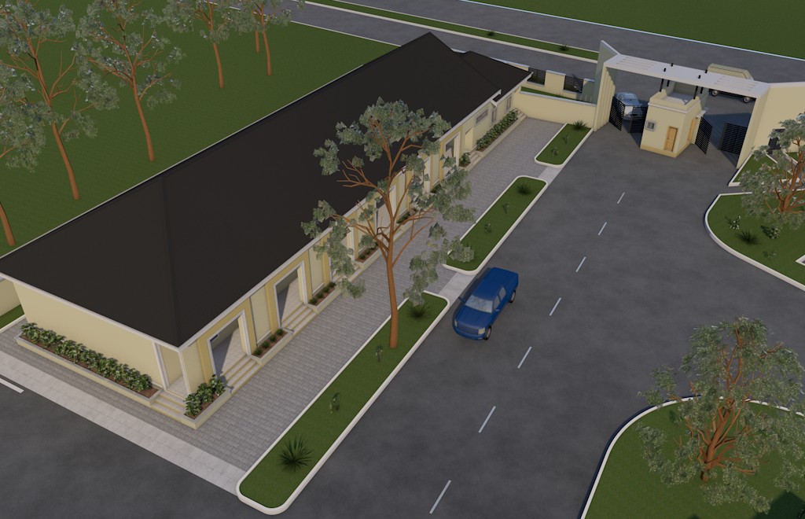
Community/Welcome Center and Office

Slide 16
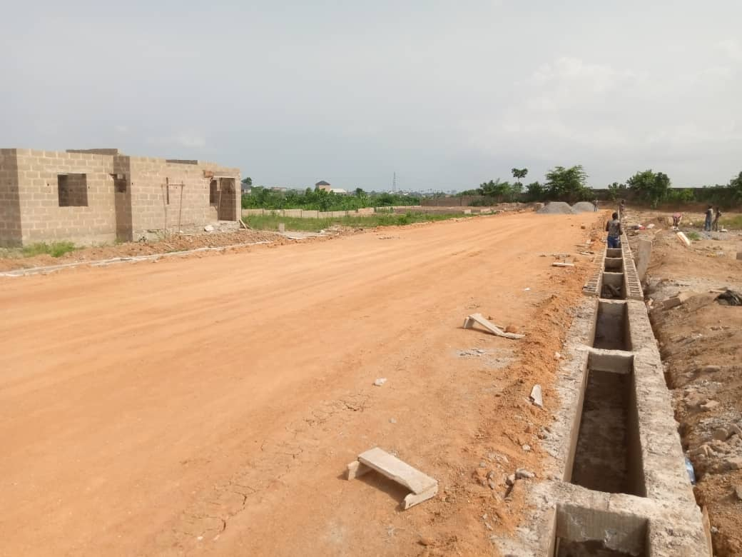
Road construction within the Estate

Slide 17
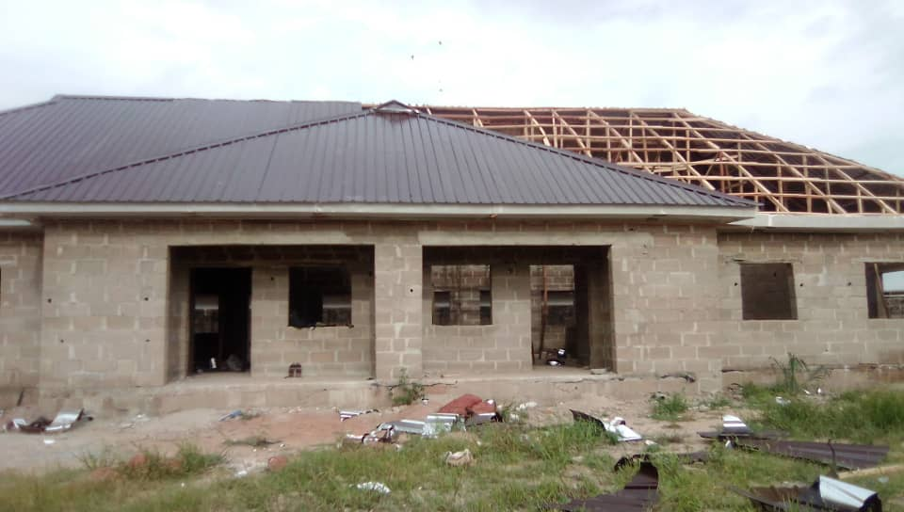
3 Bedroom Semi detached at roofing stage

Slide 18
Summary
All costs are inclusive of Civil-Infrastructure
Bungalow
4 B/R Fully Detached - N21,000,000 each
3 B/R Semi Detached - N14,000,000 each
2 B/R Semi Detached - N11,500,000 each
Duplex
3B/R Town House - N16,000,000 each
Contact
Daniel Ishola +1 614 327 0123
Kunle Omotoso +1 347 372 0981

